Slide 1
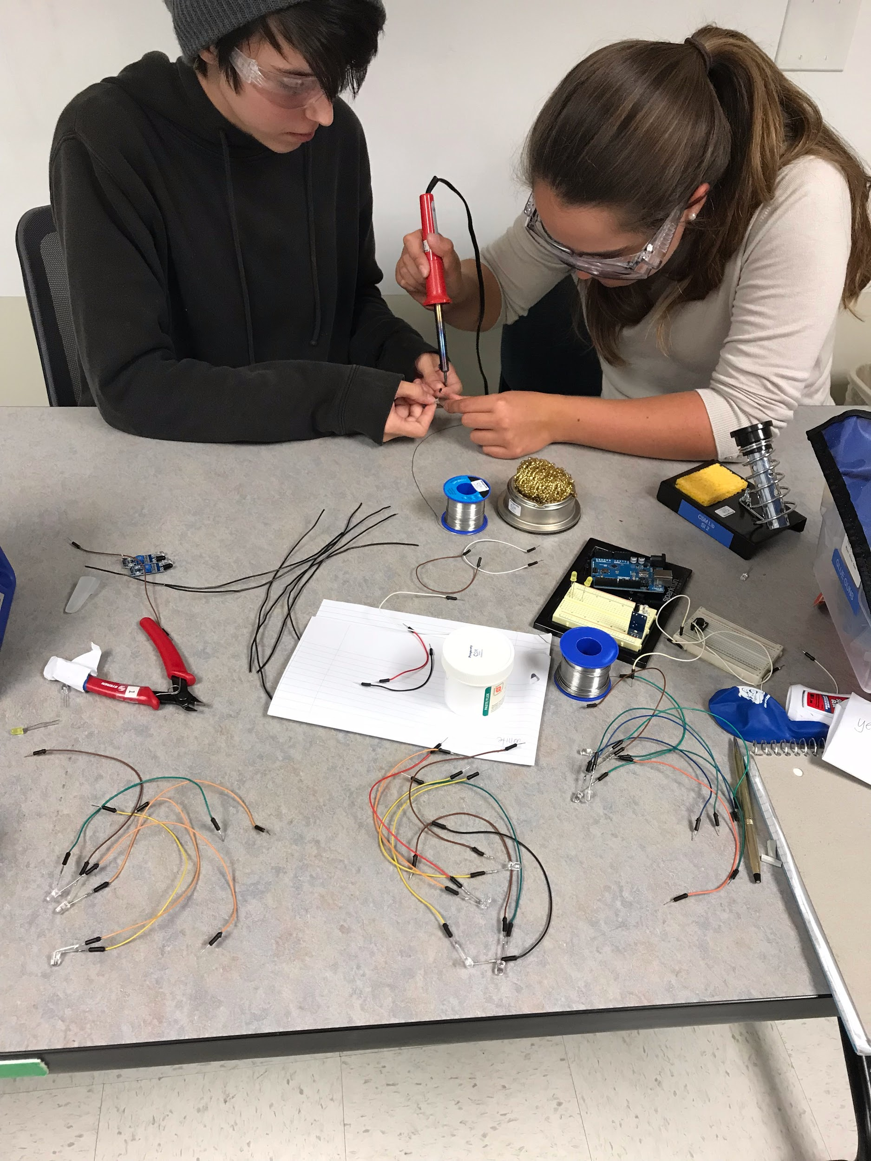
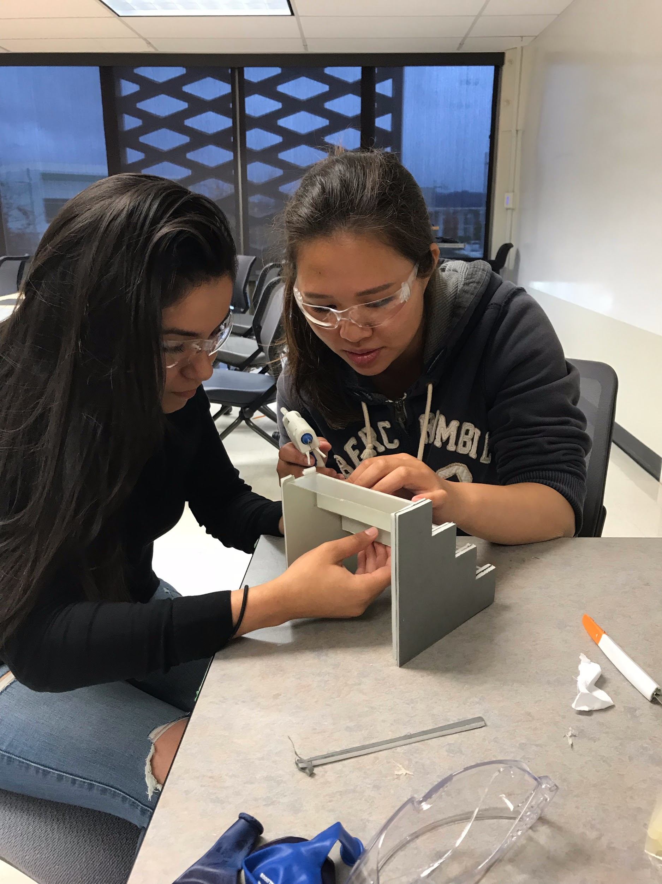
LED STAIRS
Team:
Julissa Rico
Nicko Ma
Luciana Aguirre
Nicole Rocha

Slide 2
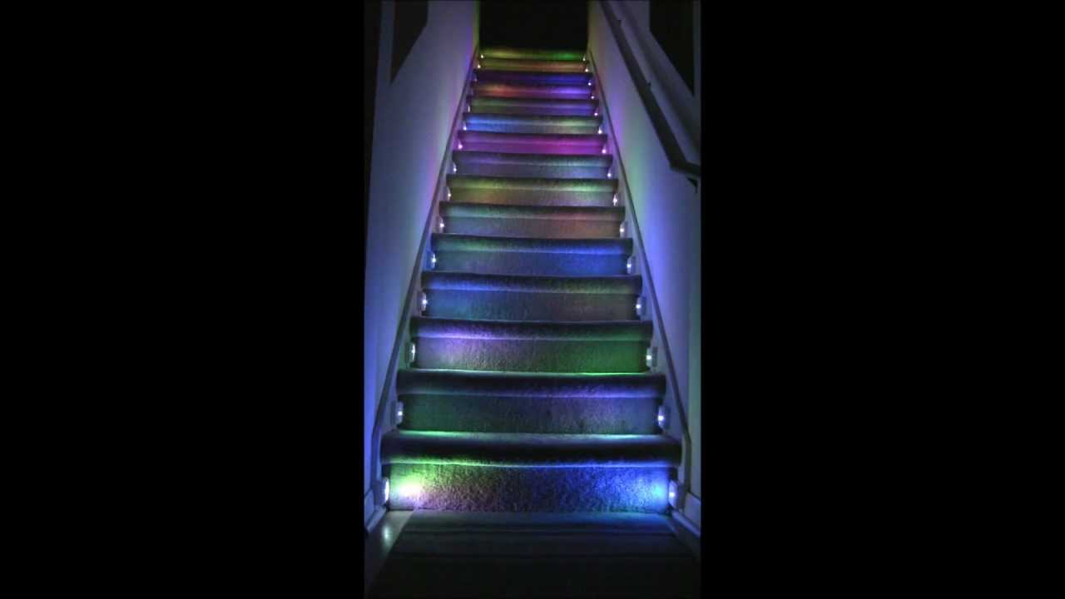
Brainstorm Process
https://www.youtube.com/watch?v=WIgiyA1UQgw
Option 1:
IR Proximity Sensor
RGB LED’s
Option 2:
Soft Pot Resistor
3 single different color LED’s

Slide 3
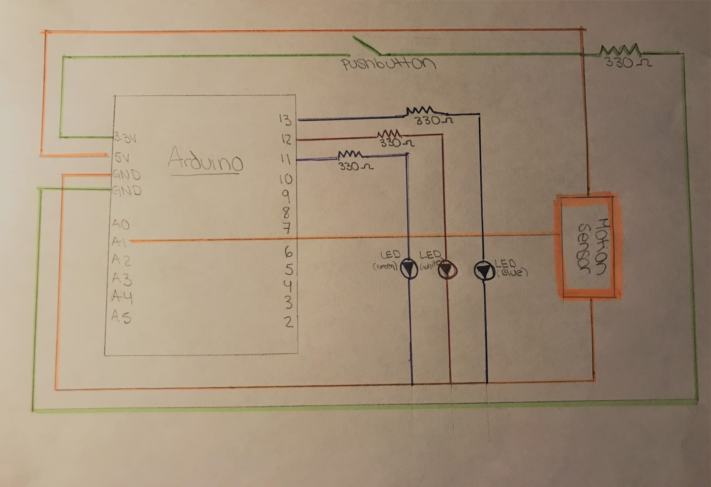
Circuit Diagram

Slide 4
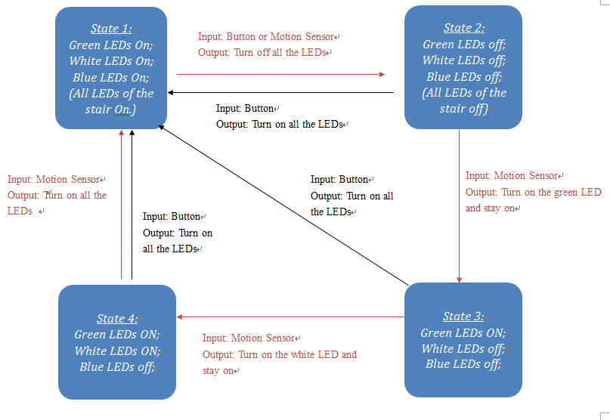

Slide 5
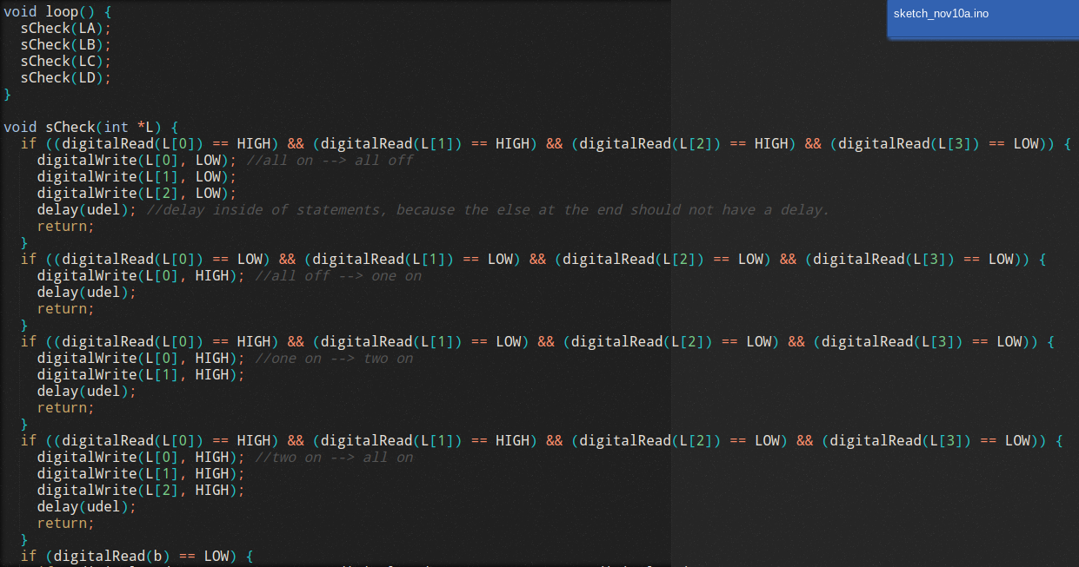
Code

Slide 6
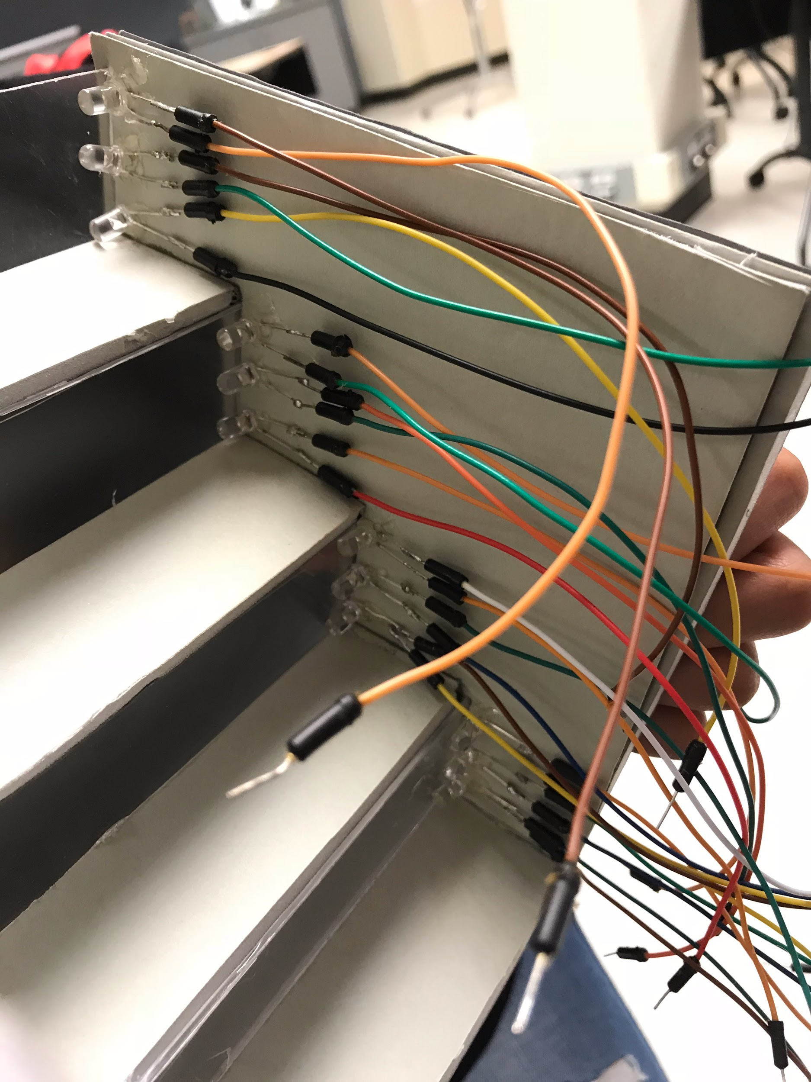
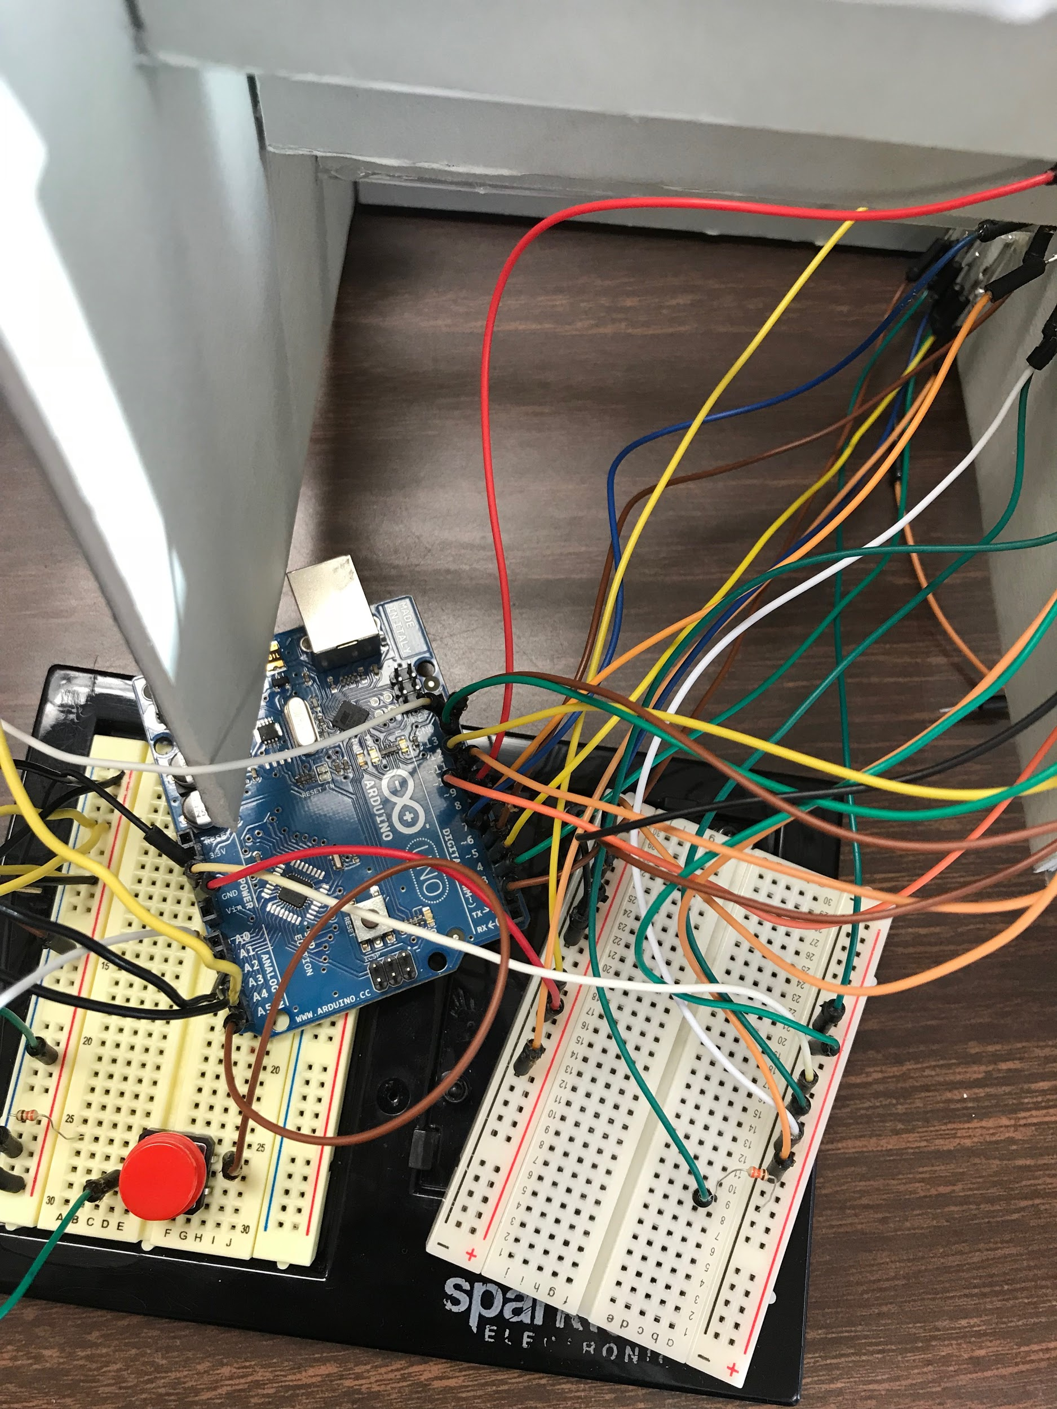
Lessons Learned
Better have all the wires organized
Soldering skill
Importance of resistors

Slide 7
Future Work
We will:
Use RGB LEDs instead of three single color LEDS
Improve the brightness of the LEDs
Hide all the wires

Slide 8
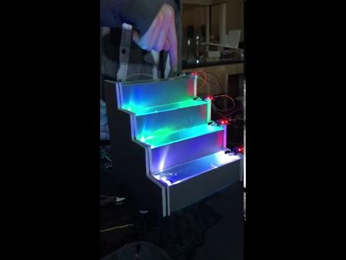
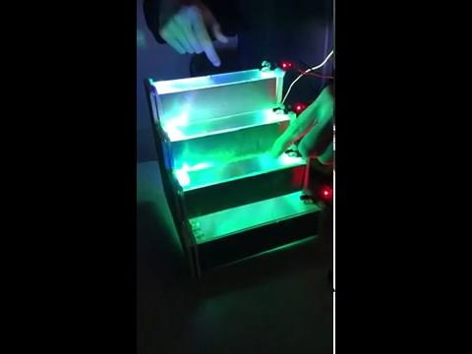
Final Product

